Slide 1

KS3 Mathematics
N2 Ordering Integers
Notes:
The aim of this unit is to teach pupils to:
Order, add, subtract, multiply and divide positive and negative numbers.
Material in this unit is linked to the Key Stage 3 Framework supplement of examples pp 48-51.

Slide 2


Introducing integers
A positive or negative whole number, including zero, is called an integer.
For example, –3 is an integer.
–3 is read as ‘negative three’.
This can also be written as –3 or (–3).
It is 3 less than 0.
0 – 3 =
–3
Or in words,
‘zero minus three equals negative three’
Notes:
Introduce the key words highlighted in orange. Distinguish between ‘minus three’ which means ‘take away three’ and ‘negative three’ which means ‘three less than zero’.
In the first case, the – sign is being used as an operation and in the second case the – sign is being used to tell us that the number is negative.
We could write a + sign in front of positive numbers although this is not usually necessary.

Slide 3


Integers on a number line
Positive and negative integers can be shown on a number line.
–8
–3
Negative integers
Positive integers
We can use the number line to compare integers.
For example,
–3 > –8
–3 ‘is greater than’ –8
Notes:
Discuss what we mean when we use the terms ‘greater than’ and ‘less than’ with negative numbers. We say that –3 is ‘greater than’ –8 because it is further along the line in the positive direction.

Slide 4
Ordering negative numbers
We can also use a number line to help us write integers in order.
Write the integers –2, 8, 2, –6, –9 and 5 in order from smallest to largest.
Look at the position of the integers on the number line:
–9
–6
–2
2
5
8
So, the integers in order are:
–9, –6, –2, 2, 5, and 8
Notes:
Together, order the numbers on the number line.

Slide 5

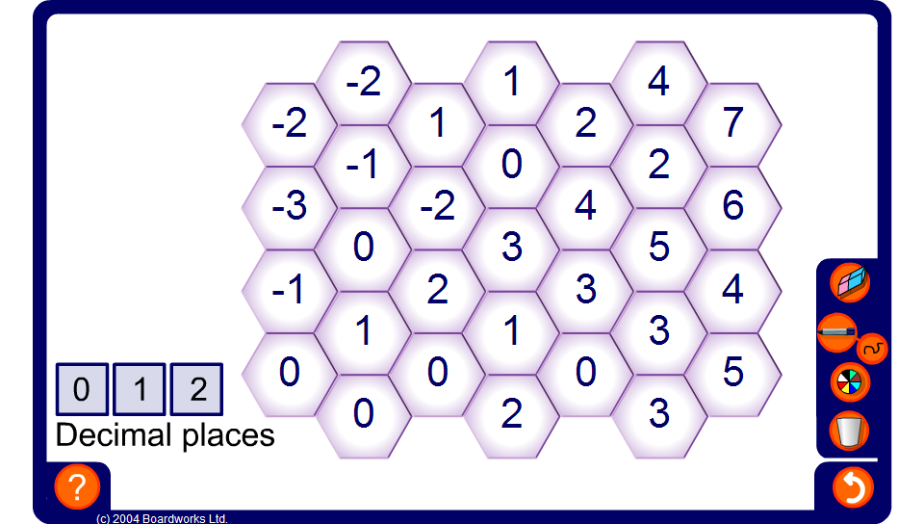
Ordered Paths
Notes:
The object of the activity is to select a starting number on the far left and to find a path from left to right. You must always move into a hexagon containing a smaller integer.
Ask pupils to come to the board to show possible paths.

